Slide 1
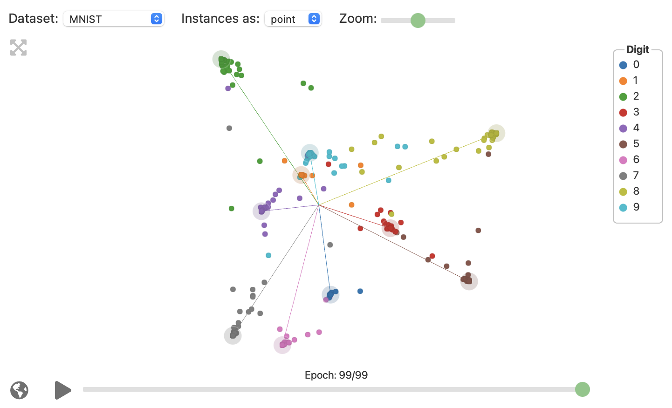
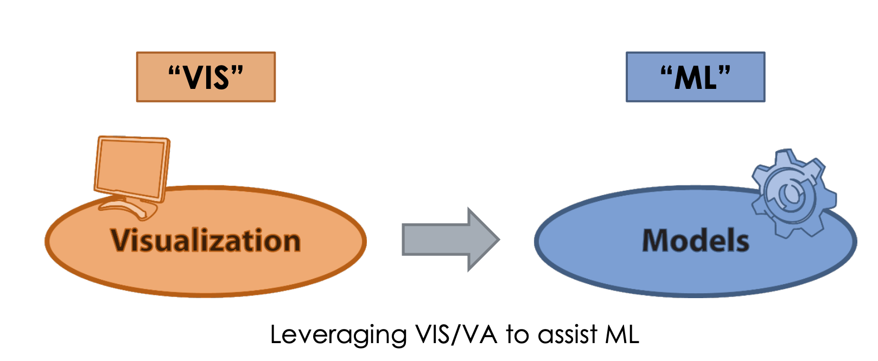
The Grand Tour
Overview
Visualization of Neural Network
Linear method
Projects high dimensional data to 2D
Relation to one aspect studied in W01-W11 and IVDA?
Model Explainer
Week 11
Examine/understand ML model
Comparative analysis
Which problem is solved with the approach?
Helps in understanding of Neuron activation at finer level
Direct link between change in data and visualization
Provide direct manipulation
Invariant to rotation of data
Drawbacks
When topology of data is concerned, like clustering the data, nonlinear methods are better for vis
With CNN, the Grand Tour can run into scalability issues
Related approaches
t-SNE (Nonlinear)
Dynamic t-SNE (Nonlinear)
PCA (Linear)
UMAP (Nonlinear)
Introduction to IVDA – Homework
Abhinav Kumar, Nidhi Agrawal
url: https://distill.pub/2020/grand-tour/

